Slide 1
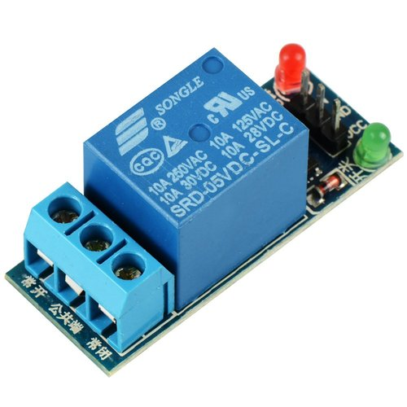
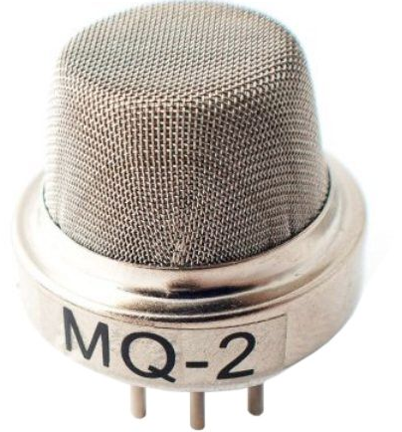
Arduino Session Eight
LAB Security System, Relays

Slide 2
Power Backup Lighting
Get any DC adapter and connect it to Arduino as indication of mains voltage presence
Connect power supply (battery) to Arduino through voltage divider to measure voltage
Connect normal power supply to (battery) (LED) lamp through relay
Connect relay to Arduino to control LED

Slide 3
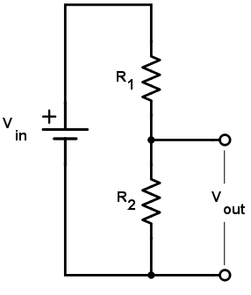
How voltage divider works
This is the basic circuit to be used, the values of each resistor can be obtained from online calculator

Slide 4
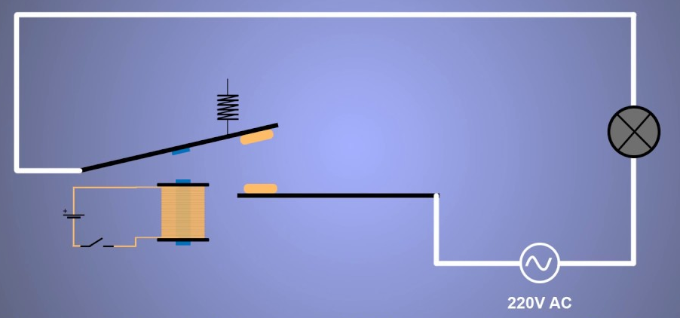
How Relay Works

Slide 5
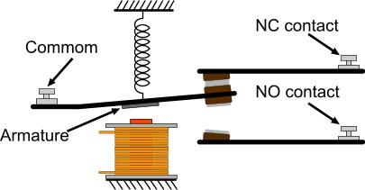
How Relay Works

